Slide 1


Team 61: HARD
Bi-Weekly Update 3 William Jachimiak, Jean Jacques Chirat,
Preston Bowyer, Aiden George
Sponsor: Professor Arya Menon
TA: Manoj Kumar Balamurugan
Notes:
Michelle

Slide 2

Project Summary
Our project seeks to solve the problem of monitoring fall injury prone individuals in assisted-care through the following implementation:
Collection of vertical position & velocity data (minimally invasive) using mmWave radar
Stream the data to Raspberry Pi to be processed by ML detection algorithm
Pi communicates positive detection result over WiFi network to Firebase cloud
Firebase interfaces with Android app to notify assisted-care workers if fall event occurs
Notes:
Kyle

Slide 3
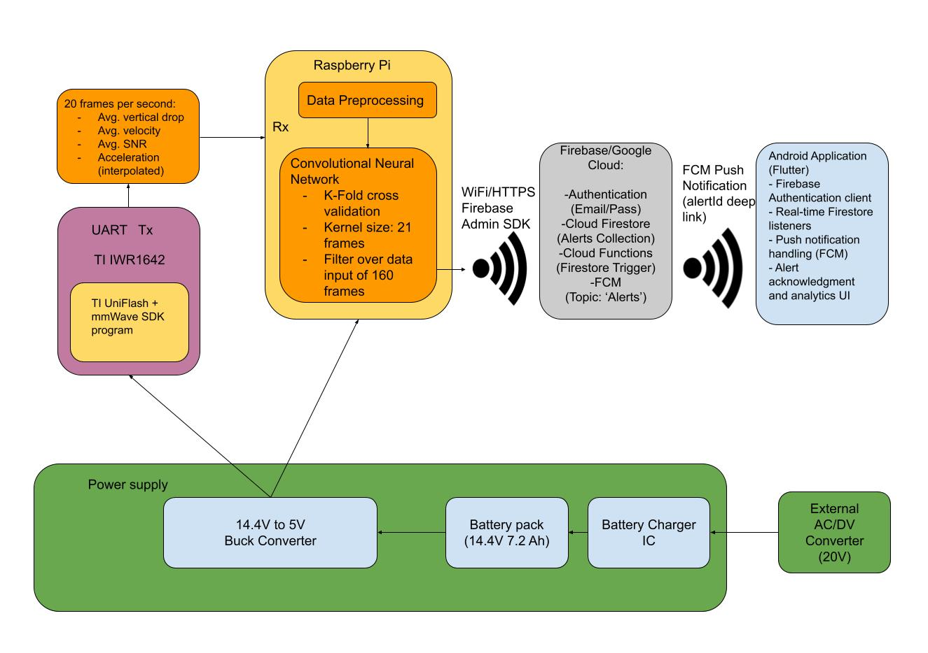
Project/Subsystem Overview
Notes:
Eric

Slide 4
Project Timeline
Subsystem Designs and Testing (completed 02/05) | Integration of SBC and ML (to complete by 02/20) | Integration of SBC and App (to complete by 02/20) | Final Integration (to complete by 03/05) | System Test (to complete by 03/26) | Validation (to complete by 04/02) | Demo and Report (to complete by 04/21)
Notes:
Eric

Slide 5
MCU/SBC William Jachimiak
Accomplishments since last update 10 hrs of effort | Ongoing progress/problems and plans until the next presentation
Finished integration with ML and App Finished verification of data transfer to ML model | Develop a functional test plan and continue testing Setting up the Raspberry Pi to run automatically on boot and if restarted

Slide 6
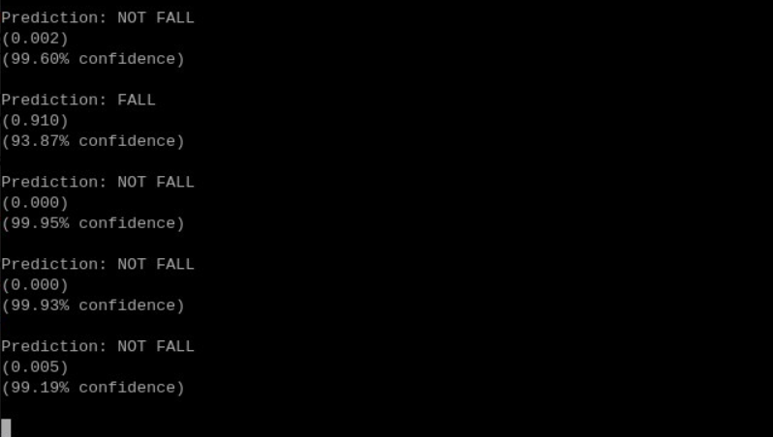
MCU/SBC William Jachimiak

Slide 7
Machine Learning Jean Jacques Chirat
Accomplishments since last update 10 hrs of effort | Ongoing progress/problems and plans until the next presentation
Added new confidence metric (ranges from 50% to 100%) Added new isolation forest check to add extra layer of validation Finished integrating with MCU - system can now do active detection in real-time while sending alerts to user-end | Do rigorous testing of training edge cases as well as normal cases Take note of failed test cases & rework training methods/data processing to fill these gaps Currently subsystem suffers from unforeseen problems with fast & sudden motions, and some other setup issues

Slide 8
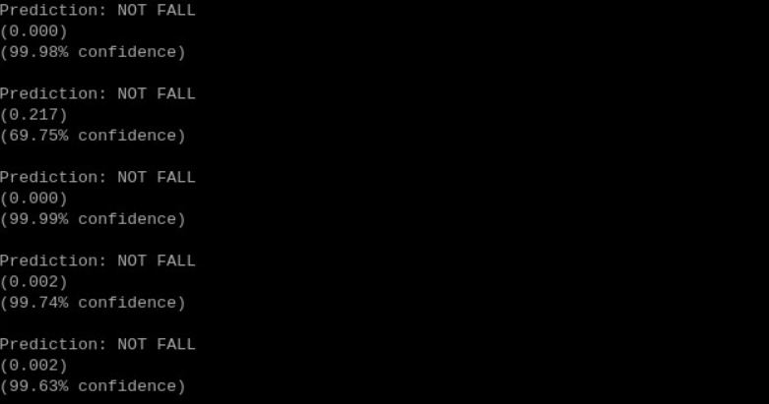
Machine Learning Jean Jacques Chirat

Slide 9
Power Supply Aiden George
Accomplishments since last update 25 hrs of effort | Ongoing progress/problems and plans until the next presentation
New Power Board Fully Soldered Initial Testing Began, with voltage regulator shown to work at ideal voltage | Voltage Regulator caught fire during testing of different voltages Resoldering needs to be completed and validation finalized Full system integration will be completed by next review

Slide 10
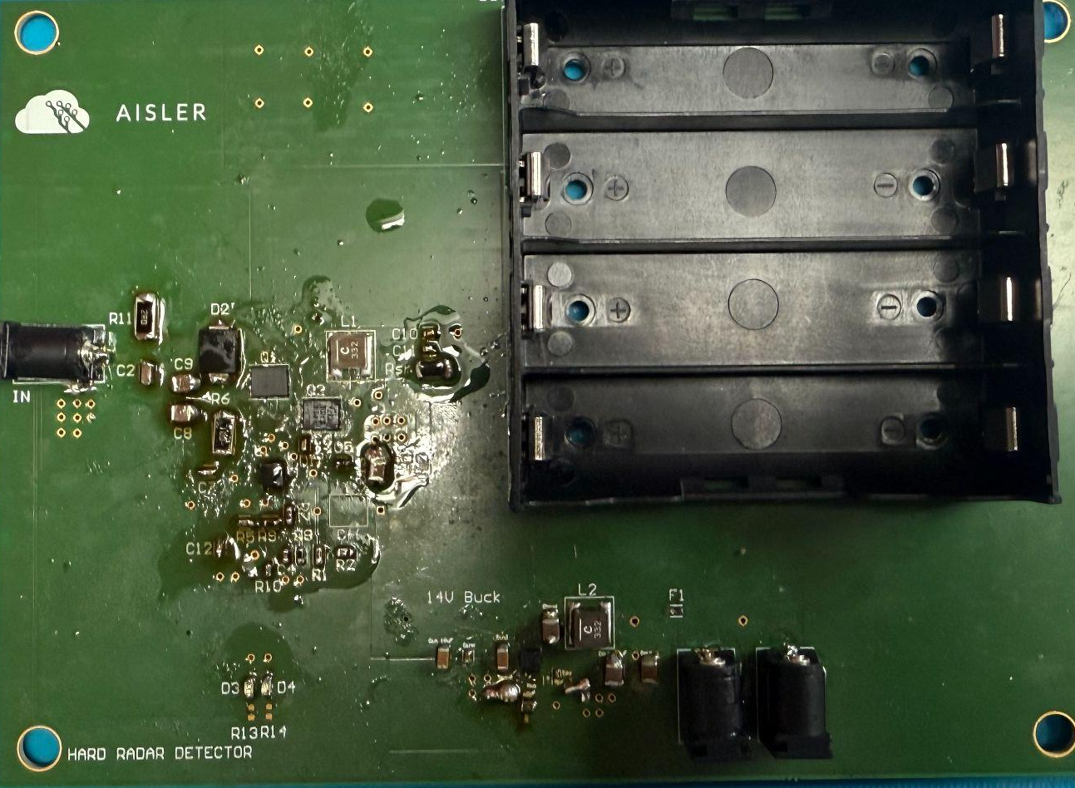
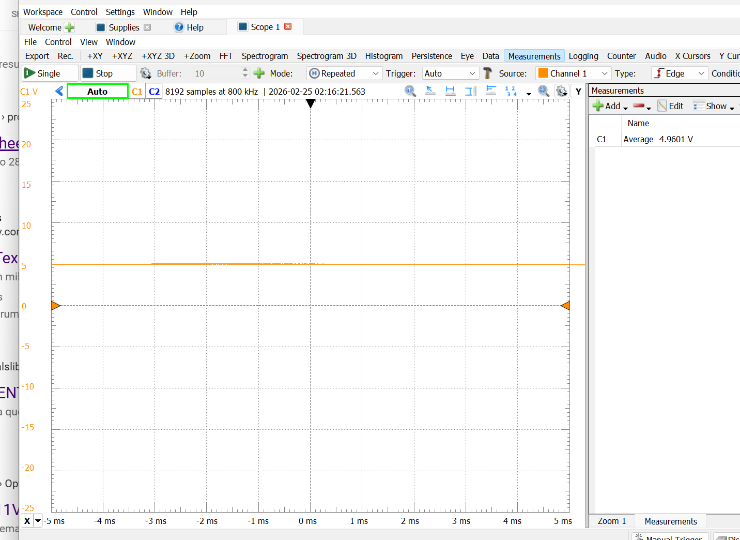
Power Supply Aiden George
Voltage Regulator Response
Full Board Layout

Slide 11
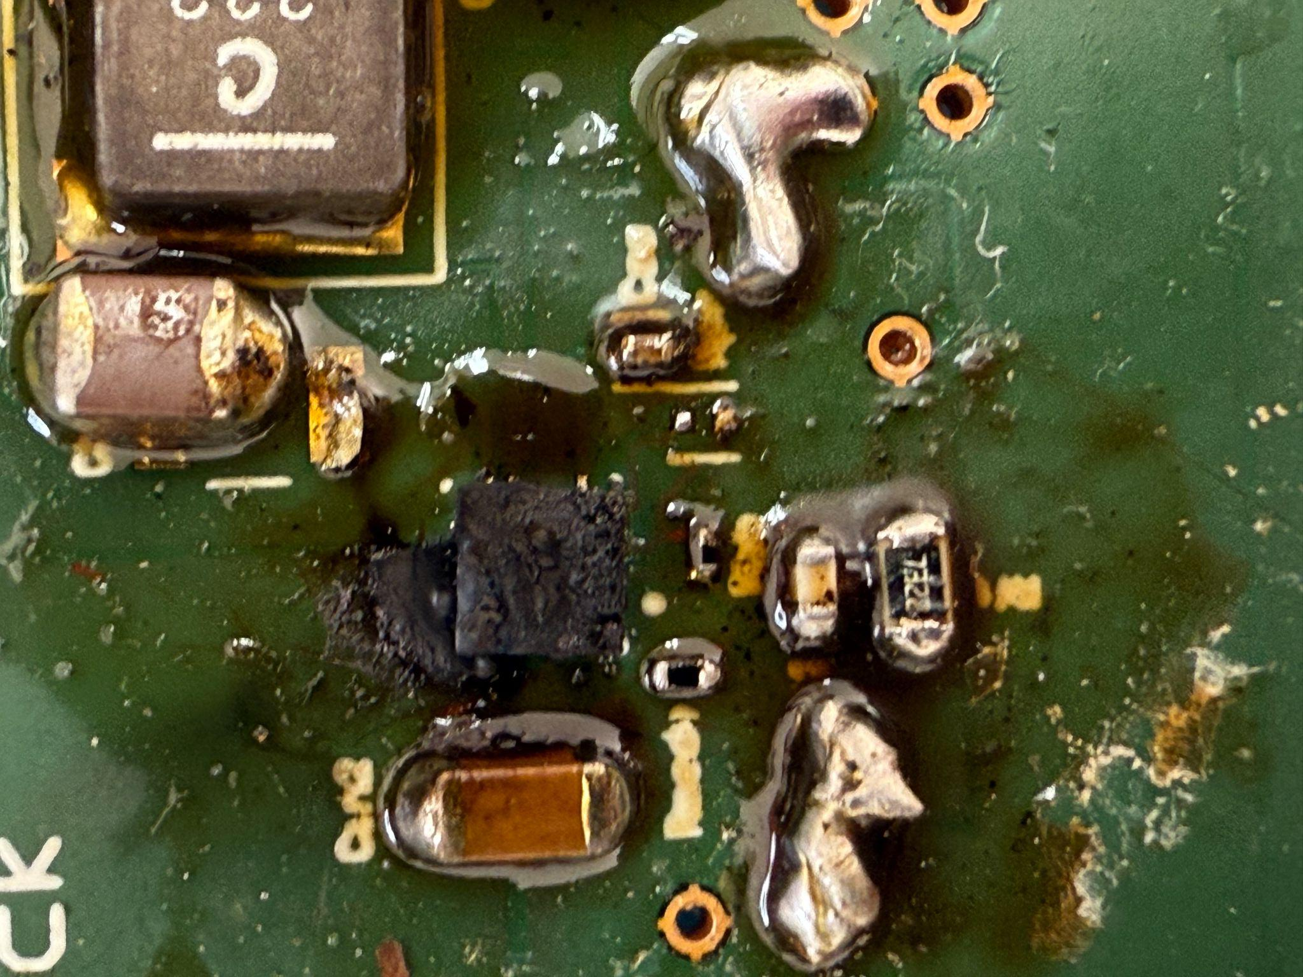
Power Supply Aiden George
Damaged Voltage Regulator

Slide 12
End User App Preston Bowyer
Accomplishments since last update 13 hrs of effort | Ongoing progress/problems and plans until the next presentation
-Integrated MCU fall signal with Pi WiFi publishing module -Verified correct payload structure (type, room, confidence) -MCU triggers fall, Pi publishes alert -Firestore document created successfully -Push notification delivered to end-user phone -Diagnosed and fixed malformed payload causing 400 errors | -Implement system service for boot-time startup -Transition to secure environment-based credentials -Validate serial device readiness at boot -Repeated end-to-end alert validation -Test WiFi interruption & recovery behavior -Evaluate duplicate alert handling

Slide 13
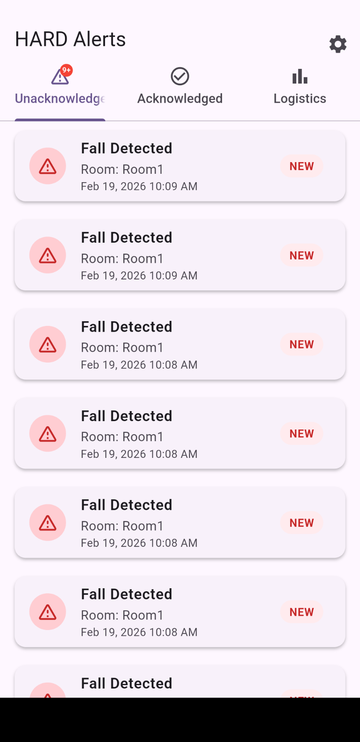
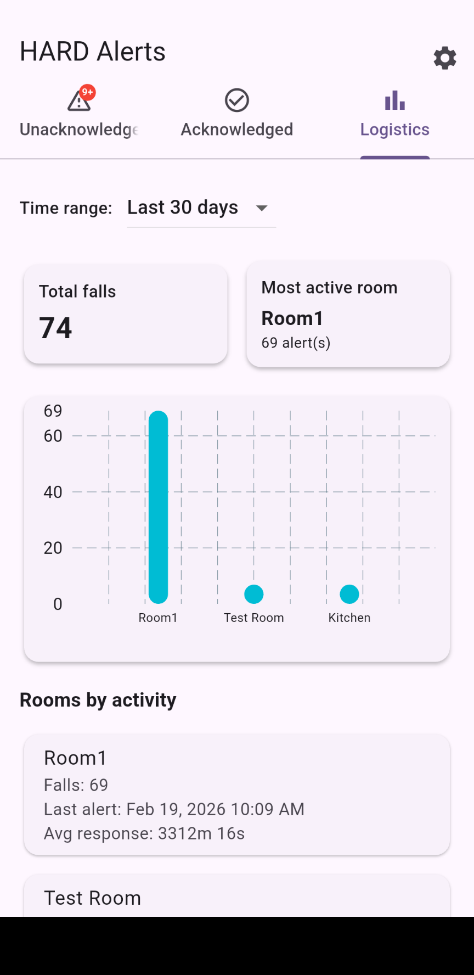
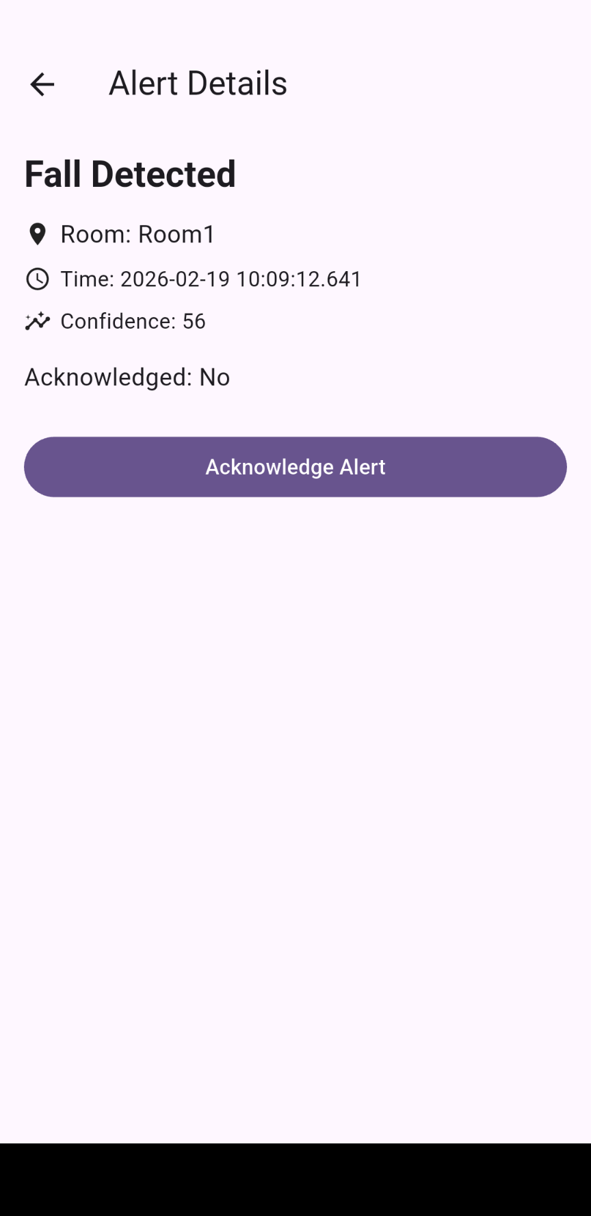
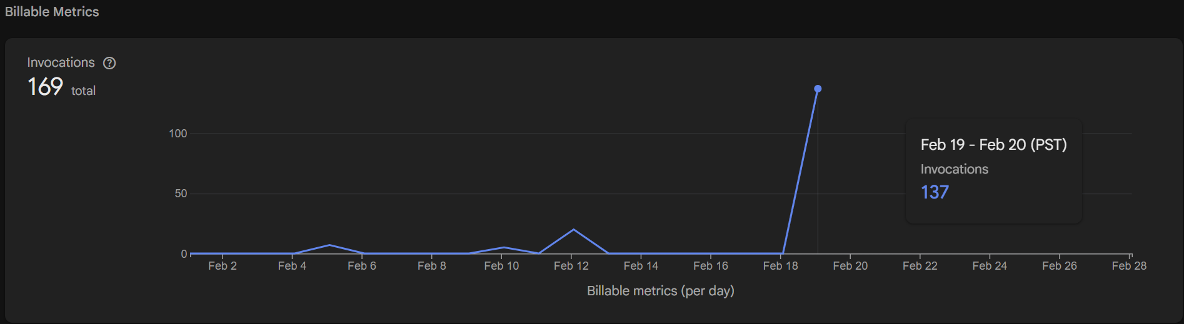
End User App Preston Bowyer

Slide 14
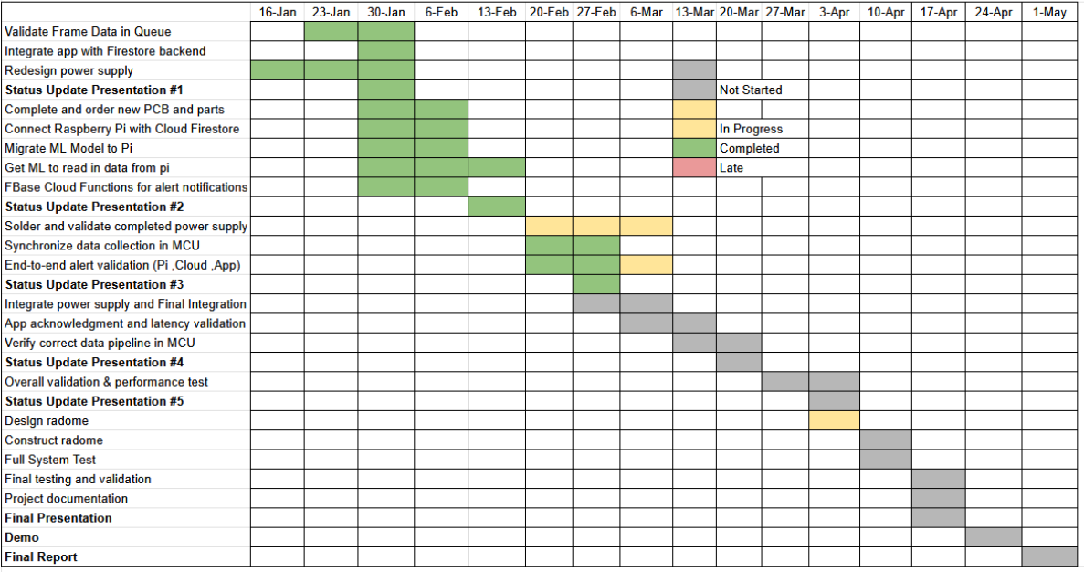
Execution Plan
Notes:
Michelle

Slide 15
Thank you!
Questions?

Slide 16
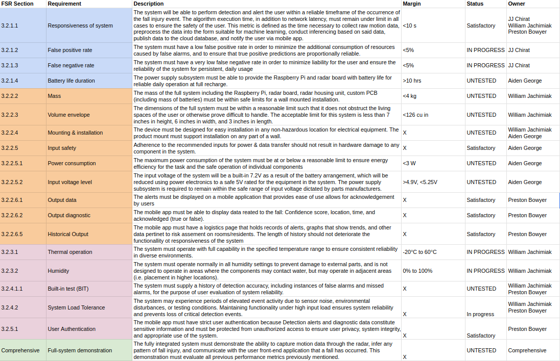
Validation Plan
Notes:
Michelle

